Slide 1

FOODAI الوصف: تطبيق يستخدم الذكاء الاصطناعي للتعرف على الأطعمة من الصور وتقديم معلومات غذائية ووصفات. الميزات: تحليل الصور، معلومات غذائية، وصفات.

Slide 2
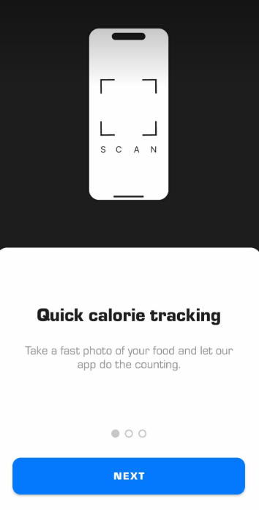
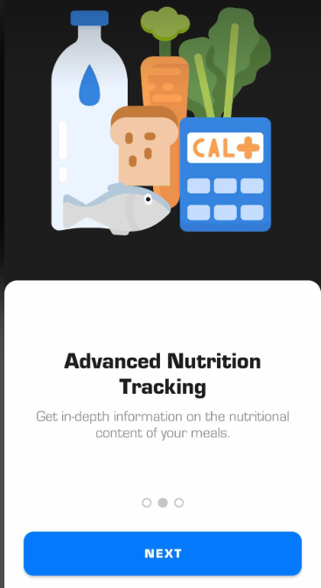
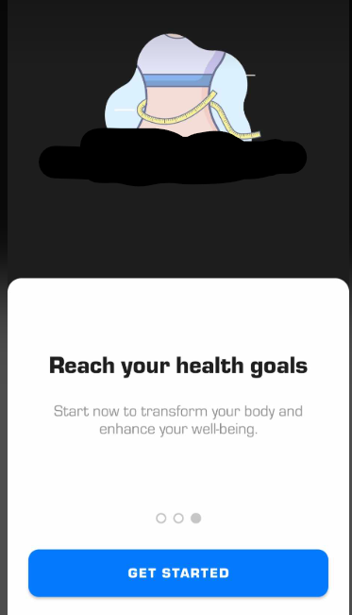
INTRO

Slide 3
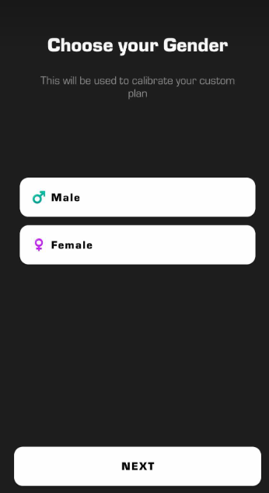
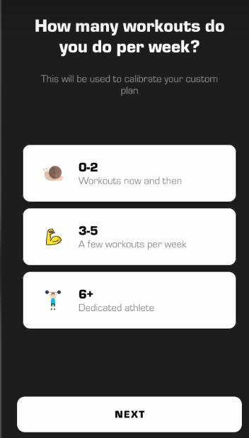
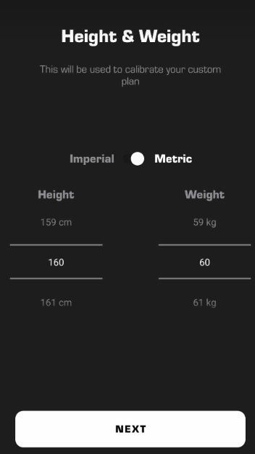
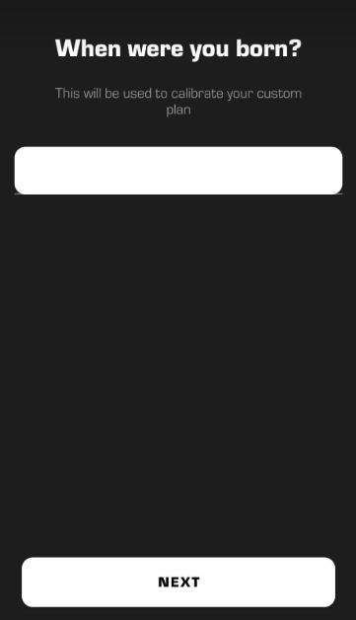
Question of user

Slide 4
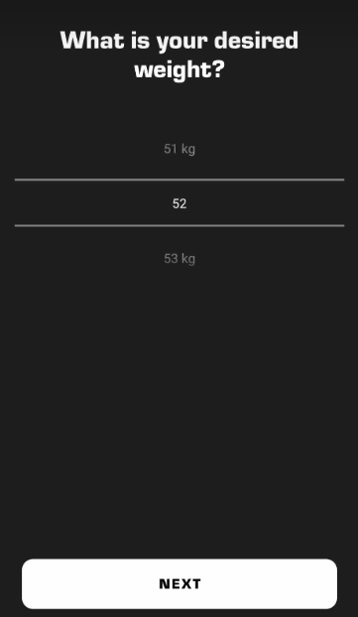
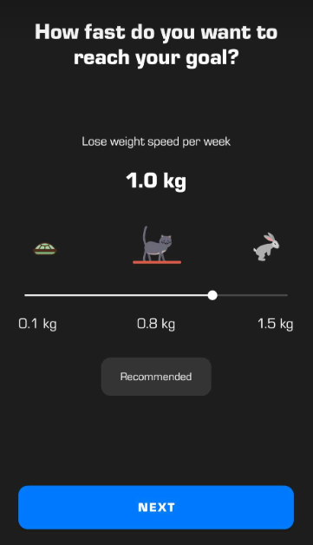
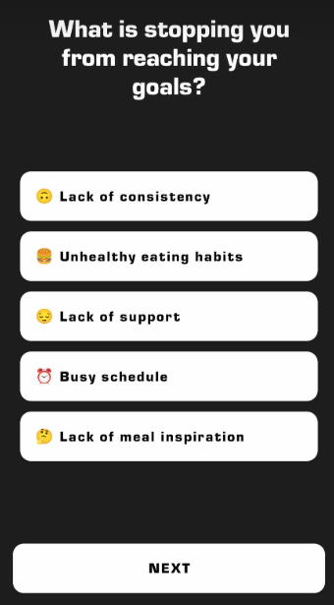
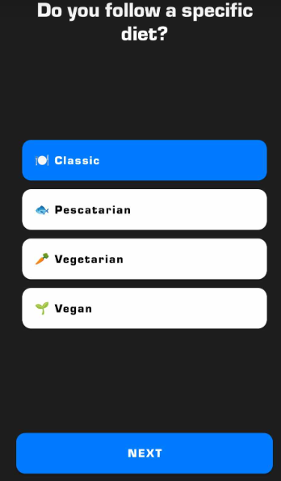
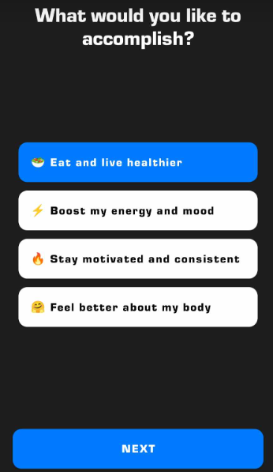

Slide 5
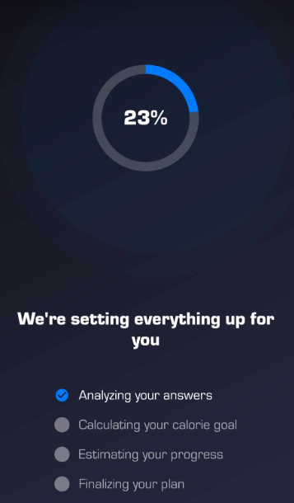
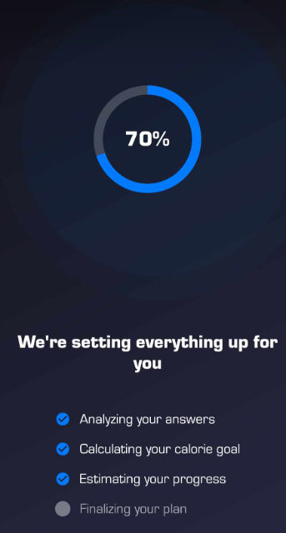
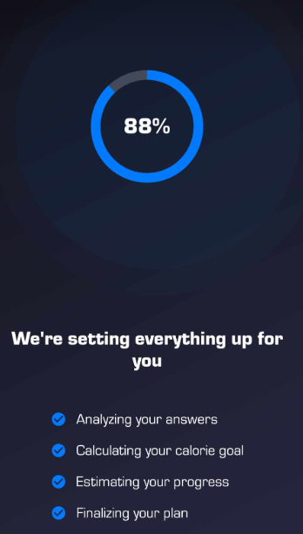
Upload dataset of user’s & analysis

Slide 6
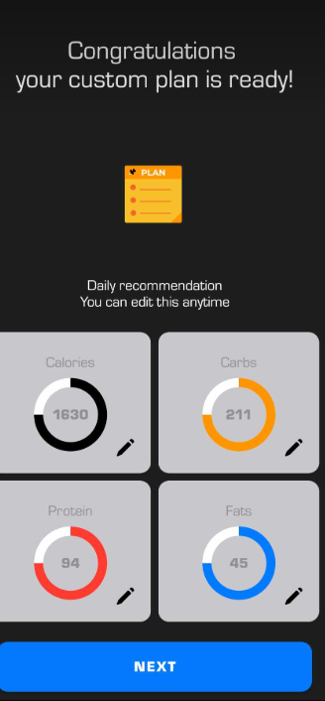
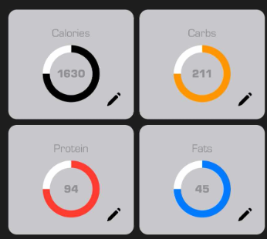
Limit amount of each item bellow

Slide 7
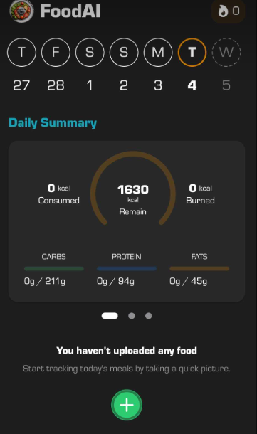
Now it open day & date of each week Daily summary take picture of today’s meal’s

Slide 8
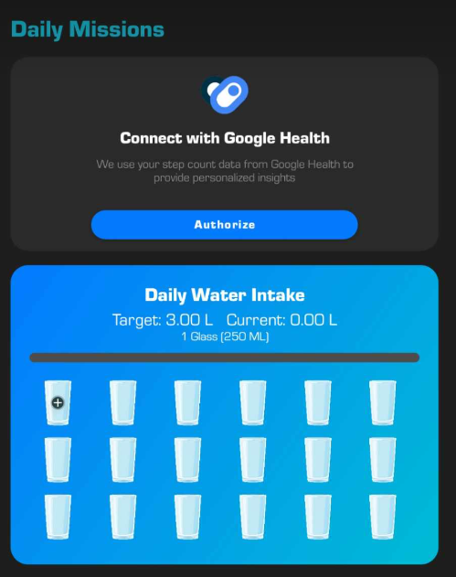
Daily Missing Daily water

Slide 9
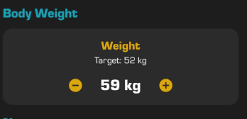
Body Weight

Slide 10
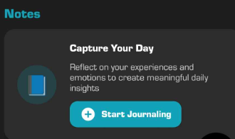
Write Notes

Slide 11
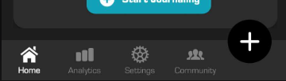
Footer

Slide 12
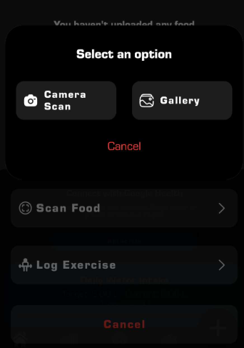
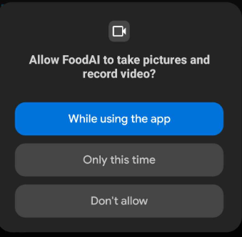
click of + button scan food log exercise if click of scan food as shown

Slide 13
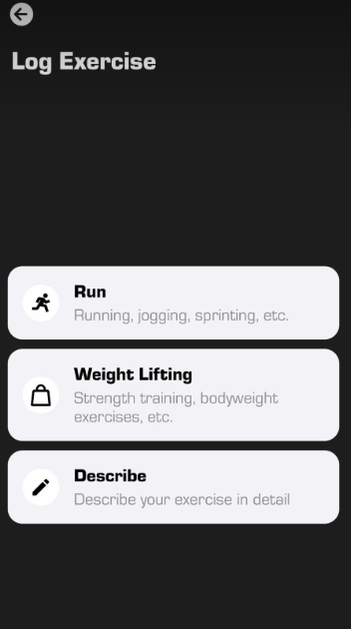
Click of log exercise

Slide 14
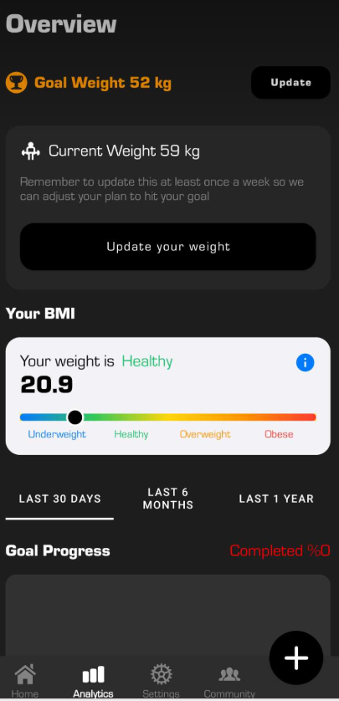
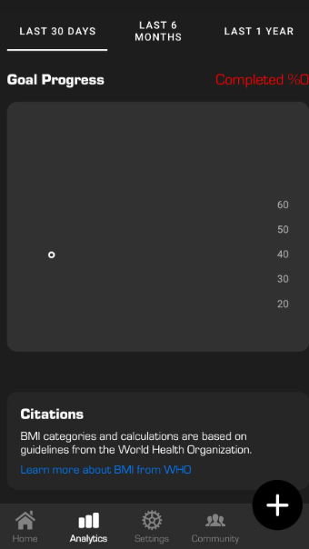
Analytics

Slide 15
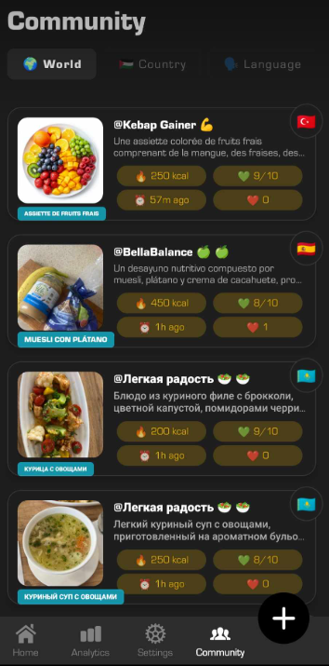

Community but in we project not need

Slide 16
2_Foodvisor الوصف: تطبيق يستخدم الذكاء الاصطناعي لتحليل صور الطعام وتقديم معلومات عن السعرات الحرارية والمكونات. الميزات تحليل الصور تقدير السعرات الحرارية معلومات غذائية مفصلة

Slide 17
Description: Foodvisor is a AI-powered food tracking app that uses artificial intelligence to analyze photos of food and provide detailed information about calories, ingredients, and nutritional content. It simplifies the process of tracking meals by allowing users to take a picture of their food instead of manually logging it.

Slide 18
Key Features of Foodvisor

Slide 19
AI-Powered Image Analysis:
Users can take a photo of their meal, and the app uses AI to identify the food items.
Recognizes a wide variety of dishes, ingredients, and portion sizes.
Calorie Estimation:
Provides an estimate of the total calories in the meal based on the analyzed photo.
Helps users stay within their daily calorie goals.
Detailed Nutritional Information:
Breaks down the meal into macronutrients (carbs, fats, proteins) and micronutrients (vitamins, minerals).
Offers insights into the nutritional value of the food.

Slide 20
4_Food Database:
Includes a large database of foods and dishes for accurate identification and analysis.
Allows users to manually adjust or add foods if the AI analysis is not fully accurate.
5_Meal Logging and Tracking:
Users can log their meals throughout the day to track their overall calorie and nutrient intake.
Provides a daily summary of calories consumed and remaining.
6_Dietary Goals and Customization:
Allows users to set personalized dietary goals (e.g., weight loss, maintenance, muscle gain).
Supports various diets, such as keto, vegan, or low-carb.
7_User-Friendly Interface:
Simple and intuitive design makes it easy to take photos, log meals, and view nutritional data.
Visual progress charts and reports help users stay motivated.

Slide 21
How Foodvisor Works:
Take a Photo:
Snap a picture of your meal using the app's camera feature.
AI Analysis:
The app identifies the food items and estimates portion sizes.
Get Nutritional Info:
View calorie count, macronutrients, and other nutritional details.
Log and Track:
Save the meal to your daily log and track your progress toward your goals.

Slide 22
من هو تطبيق Foodvisor الموجه؟
الأفراد المشغولون: الأشخاص الذين يريدون طريقة سريعة وسهلة لتتبع وجباتهم دون إدخال يدوي.
المستخدمون المهتمون بصحتهم: أولئك الذين يرغبون في مراقبة استهلاكهم من السعرات الحرارية وعاداتهم الغذائية.
المتبعون للأنظمة الغذائية المهتمون بالتكنولوجيا: الأفراد الذين يستمتعون باستخدام الذكاء الاصطناعي والتكنولوجيا لتبسيط روتينهم الصحي.
المستخدمون المتخصصون في الأنظمة الغذائية: الأشخاص الذين يتبعون أنظمة غذائية محددة ويحتاجون إلى تتبع دقيق لكمية الطعام التي يتناولونها.

Slide 23
يُركز على سهولة الاستخدام من خلال تحليل الصور المُدعّم بالذكاء الاصطناعي لتقديرات سريعة للسعرات الحرارية والعناصر الغذائية. يُعد Foodvisor خيارًا ممتازًا لأي شخص يبحث عن طريقة سريعة ومرئية وتقنية لتتبع وجباته والبقاء على اطلاع دائم بأهدافه الغذائية. وهو مفيد بشكل خاص لمن يجدون التسجيل اليدوي مُملًا أو مُستهلكًا للوقت.

Slide 24
3_SeeFood الوصف: تطبيق يستخدم الذكاء الاصطناعي للتعرف على الأطعمة من الصور وتقديم معلومات عنها. الميزات: تحليل الصور. التعرف على أنواع الأطعمة.

Slide 25
Description: SeeFood is a fun and innovative AI-powered app that uses artificial intelligence to identify food items from photos. It’s designed to help users quickly recognize what they’re eating and provide basic information about the food. While it’s not as detailed as some other nutrition apps, it’s a simple and entertaining tool for food identification.

Slide 26
Key Features of SeeFood:
AI-Powered Image Recognition:
Users can take a photo of their food, and the app uses AI to identify the type of food or dish.
Recognizes a wide variety of common foods and meals.
Food Identification:يحدد نوع الطعام
Quickly tells you what the food is (e.g., pizza, sushi, salad).
Useful for identifying unfamiliar or exotic dishes.
Basic Food Information:
Provides general information about the identified food, such as its origin, common ingredients, or cultural significance.
Does not typically include detailed nutritional information like calories or macronutrients.يوفر معلومات عامة عن الطعام المحدد، مثل أصله، ومكوناته الشائعة، وأهميته الثقافية.
User-Friendly Interface:
Simple and intuitive design makes it easy to take photos and get instant results.
Focuses on quick identification rather than in-depth analysis.
Fun and Entertaining:
Designed to be lighthearted and enjoyable, making it a great tool for food enthusiasts or curious users.
Can be used as a game to test how well the AI identifies different foods.

Slide 27
How SeeFood Works:
Take a Photo:
Snap a picture of your food using the app’s camera feature.
AI Analysis:
The app analyzes the photo and identifies the food item.
Get Results:
View the name of the food and basic information about it.

Slide 28
Who Is SeeFood For?
Food Enthusiasts: People who enjoy exploring and learning about different types of food.
Travelers: Individuals who want to identify unfamiliar dishes while traveling.
Curious Users: Those who want a quick and easy way to recognize what they’re eating.
Tech Lovers: Users who enjoy experimenting with AI-powered apps.

Slide 29
Why Use SeeFood? Simplicity: No complicated logging or tracking—just take a photo and get instant results. Entertainment: A fun way to learn about food and test the AI’s capabilities. Quick Identification: Useful for identifying unknown or exotic dishes.

Slide 30
SeeFood
تطبيق خفيف وممتع لكل من يرغب في
التعرف بسرعة على أصناف الطعام أو معرفة المزيد عن ما يتناوله. مع أنه لا يوفر تتبعًا متقدمًا للقيمة الغذائية، إلا أنه أداة رائعة لمحبي الطعام والباحثين عن المعرفة!

Slide 31
4. NutritionAI الوصف: تطبيق يستخدم الذكاء الاصطناعي لتحليل صور الطعام وتقديم معلومات غذائية مفصلة. الميزات تحليل الصور. معلومات غذائية. توصيات صحية.

Slide 32
Description: NutritionAI is an advanced AI-powered nutrition app that uses artificial intelligence to analyze photos of food and provide detailed nutritional information. It goes beyond simple food identification by offering insights into calories, macronutrients, micronutrients, and even personalized health recommendations. It’s designed for users who want a high-tech, data-driven approach to tracking their diet and improving their health.

Slide 33
Key Features of NutritionAI:
AI-Powered Image Analysis:
Users can take a photo of their meal, and the app uses AI to identify the food items and estimate portion sizes.
Recognizes a wide variety of dishes, ingredients, and cuisines.
Detailed Nutritional Information:
Provides a breakdown of calories, macronutrients (carbs, fats, proteins), and micronutrients (vitamins, minerals).
Offers insights into the nutritional value of the meal, helping users make informed dietary choices.
Personalized Health Recommendations:
Based on the user’s dietary habits and goals, the app provides tailored recommendations for healthier eating.
Suggests alternative foods or meal adjustments to improve nutritional balance.
Meal Logging and Tracking:
Allows users to log their meals and track their daily intake of calories and nutrients.
Provides a summary of daily, weekly, and monthly progress toward health goals.
Dietary Goal Customization:
Users can set personalized goals for weight loss, weight gain, muscle building, or general health.
Supports specific diets, such as keto, vegan, gluten-free, or low-sodium.

Slide 34
6_Integration with Health Devices:
Syncs with fitness trackers, smart scales, and health apps (e.g., Apple Health, Google Fit) to provide a comprehensive overview of health metrics.
7_Recipe Suggestions:
Offers healthy recipe ideas based on the user’s dietary preferences and nutritional needs.
Helps users plan meals that align with their health goals.
8_User-Friendly Interface:
Clean and intuitive design makes it easy to take photos, log meals, and view nutritional data.
Visual charts and graphs help users track their progress over time.

Slide 35
How NutritionAI Works:
Take a Photo:
Snap a picture of your meal using the app’s camera feature.
AI Analysis:
The app identifies the food items, estimates portion sizes, and calculates nutritional content.
Get Nutritional Info:
View detailed information about calories, macronutrients, and micronutrients.
Receive Recommendations:
Get personalized suggestions for healthier eating based on your dietary habits and goals.
Log and Track:
Save the meal to your daily log and monitor your progress toward your health goals.

Slide 36
Who Is NutritionAI For?
Health-Conscious Individuals: People who want detailed insights into their diet and nutrition.
Tech-Savvy Users: Those who enjoy using AI and advanced technology to improve their health.
Diet-Specific Users: Individuals following specific diets (e.g., keto, vegan, gluten-free) who need accurate tracking and recommendations.
Fitness Enthusiasts: Athletes or gym-goers who want to optimize their nutrition for performance.
Weight Management: People looking to lose, gain, or maintain weight through better dietary choices.

Slide 37
Why Use NutritionAI?
Accuracy: Uses advanced AI to provide reliable nutritional analysis.
Personalization: Tailors recommendations to your unique dietary needs and goals.
Comprehensive Tracking: Goes beyond calories to track macronutrients, micronutrients, and overall health.
Convenience: Simplifies food logging with AI-powered photo analysis.
Health Improvement: Provides actionable recommendations to help you eat healthier and achieve your goals.

Slide 38
5_EatLove الوصف: تطبيق يستخدم الذكاء الاصطناعي لتقديم توصيات غذائية ووصفات بناءً على الصور والتفضيلات الشخصية. الميزات: تحليل الصور. توصيات وصفات. تخطيط وجبات.

Slide 39
6_. Innit الوصف: تطبيق يستخدم الذكاء الاصطناعي لتحليل الصور وتقديم وصفات تفاعلية بناءً على المكونات. الميزات: تحليل الصور. وصفات تفاعلية. توصيات مخصصة.

Slide 40
7 Mealime الوصف: تطبيق يساعد في تخطيط الوجبات وتقديم وصفات بناءً على تفضيلاتك الغذائية، مع ميزات تحليل الصور. الميزات: تحليل الصور تخطيط وجبات. توصيات وصفات.

Slide 41
8Yummly الوصف: تطبيق يستخدم الذكاء الاصطناعي لتقديم وصفات مخصصة بناءً على تفضيلاتك الغذائية، مع ميزات تحليل الصور. الميزات: تحليل الصور. توصيات وصفات. تخطيط وجبات.

Slide 42
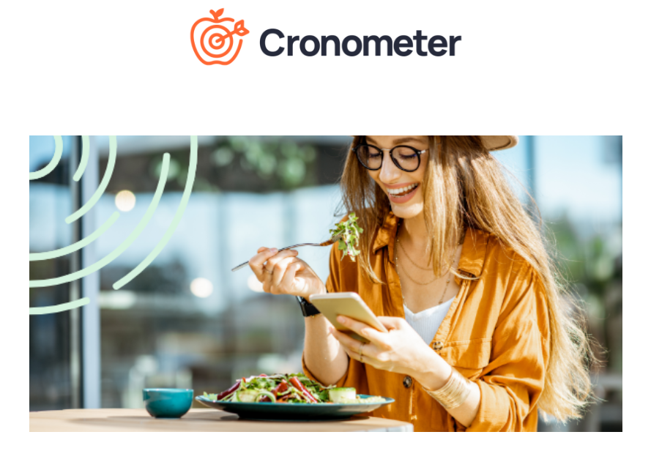
9_cronometer

Slide 43
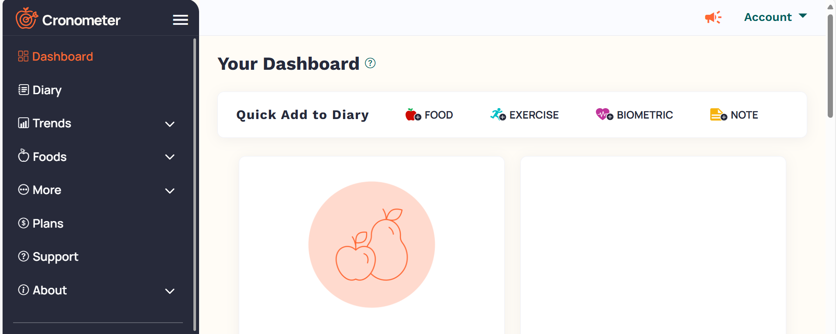

Slide 44
Cronometer Does:
Food Logging:
Users can log the foods they eat to track their daily calorie intake and nutrient consumption.
Nutrition Tracking:
Tracks macronutrients (carbs, fats, proteins) and micronutrients (vitamins, minerals).
Health Metrics:
Users can track biometrics like weight, body fat percentage, and blood sugar levels.

Slide 45
Also
Goal Setting:
Allows users to set personalized goals for weight loss, weight gain, or maintenance.
Provides recommendations based on user profiles (age, gender, weight, activity level, etc.).
Exercise Tracking:
Users can log workouts and track calories burned.
Syncs with fitness trackers to automatically import exercise data.
Dietary Customization:
Supports various diets, including keto, vegan, paleo, and more.
Allows users to set custom macronutrient ratios.

Slide 46
Key Features of Cronometer
Comprehensive Nutrition Database:
Includes detailed nutritional information for thousands of foods.
Sources data from reputable databases like the USDA.
Barcode Scanner:
Users can scan barcodes on packaged foods to quickly log them.
Customizable Dashboards:
Users can customize their dashboard to display the metrics most important to them (e.g., calories, protein, vitamin D).
Gold Subscription (Premium Features):
Ad-Free Experience: Removes ads for a smoother user experience.
Faster Logging: Streamlines the food logging process.
Advanced Metrics: Access to additional health metrics and reports.
Meal Timestamps: Track when meals are consumed.
Custom Targets: Set personalized nutrient targets.

Slide 47
Community and Support:
Cronometer has an active community on social media platforms like Instagram, TikTok, Facebook, and Reddit.
Offers customer support via email for troubleshooting and assistance.
Mobile and Desktop Compatibility:
Available as a mobile app (iOS and Android) and a web-based platform.
Syncs data across devices for seamless tracking.
Research-Backed:
The app emphasizes the importance of food journaling for weight loss and behavior change, citing studies that show its effectiveness.

Slide 48
Who Is Cronometer For? Health Enthusiasts: People who want to optimize their nutrition and fitness. Weight Management: Individuals looking to lose, gain, or maintain weight. Diet-Specific Users: Those following specific diets (e.g., keto, vegan, paleo). Athletes: Individuals who need to track macronutrient intake for performance. Medical Conditions: People with dietary restrictions or nutrient deficiencies who need detailed tracking.

Slide 49
Why Use Cronometer? Accuracy: Relies on verified nutritional data. Customization: Tailors to individual goals and dietary preferences. Comprehensive Tracking: Goes beyond calories to track micronutrients and biometrics. Community Support: Access to a supportive user community and professional support team.

Slide 50
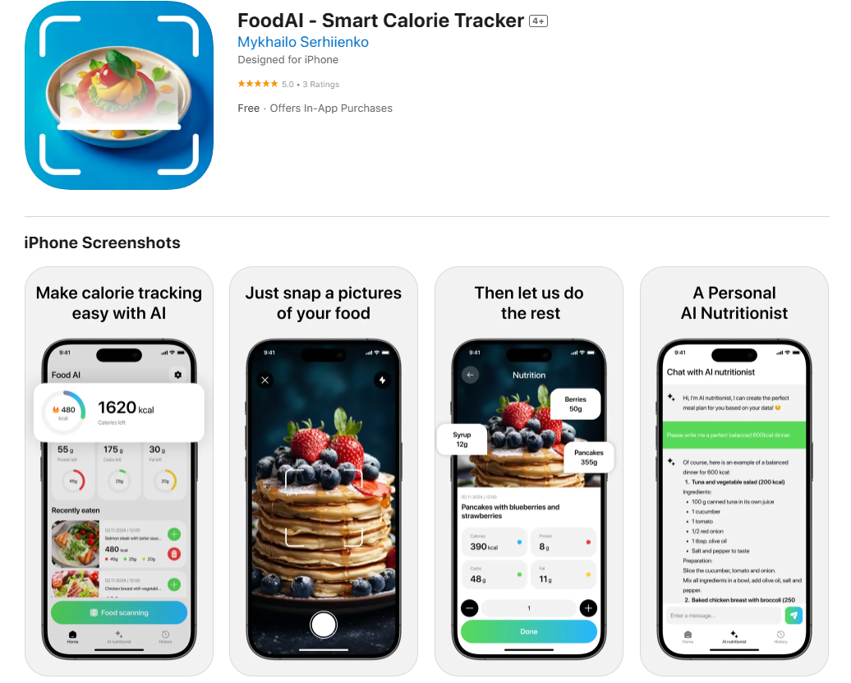
OTHER APP

